Slide 1
Spotlight Theory
Consistent with the idea that spatial locations can be enhanced when they fall in and around the spotlight, participants who correctly named letters appearing at multiple locations in the visual field were more likely to succeed at an orientation discrimination task when the forms to be discriminated appeared near the letters.
However, a number of experiments have shown that attention can be directed to a single object, even if superimposed on another object, demolishing the idea that a “spotlight” of attention highlights information in a particular spatial region.

Slide 2
Spotlight Theory
If that were true, all objects would be selected together but we know that one object can be preferentially selected.
Another difficulty is the assumption of the spotlight model that the beam of attention sweeps through space.
If that’s what happens, one would expect that if an obstacle intervened in the course of the sweep, attention would be captured or hampered by this obstacle.

Slide 3
Feature Integration Theory and Guided Search
In Disjunctive (or feature) search trials the target differs from the other characters or symbols—the distractors—by a single feature, such as shape (circle among squares).
Distractor is a nonrelevant stimulus that is supposed to be ignored.
The target is defined by a conjunction of features—here, color (blue versus white) and shape (circle versus square) in Conjunctive search trials.

Slide 4
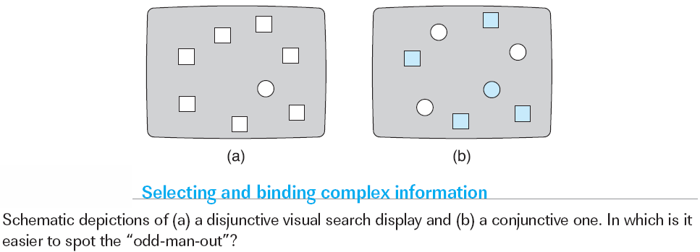
Feature Integration Theory and Guided Search

Slide 5
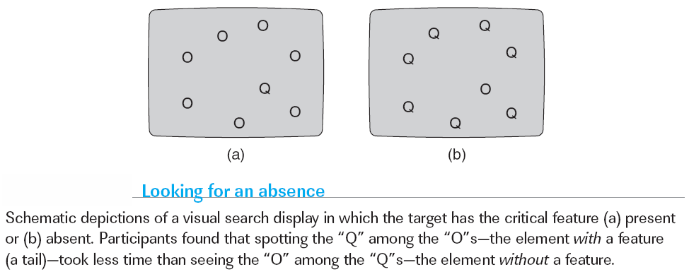
Feature Integration Theory and Guided Search
Notes:
Comprehension Check:
1. What are the differences between a spotlight view of attention and a feature in­tegration view of attention?
2. Distinguish between “attention operating early” and “attention operating late” and provide examples of studies that support each of these two views.

Slide 6
Looking to the Brain
Electrophysiology and Human Attention
Functional Neuroimaging and Transcranial Magnetic Stimulation
Notes:
The study of attention has become a very hot topic in the twenty-first century be­cause of a number of very successful studies of the neural basis of attention. These in turn have furthered our knowledge of the mechanisms that give rise to atten­tion. For example, it is now a well established behavioral finding that when at­tention is directed to a location, perception of that information is enhanced. Until fairly recently, however, we did not know whether this was because the target at the cued location was more efficiently processed in the visual areas of the brain or because the motor system was biased to produce faster responses. Both these ex­planations are reasonable accounts of the findings of faster target detection. To explore further, researchers have conducted attention studies with animals and humans using various biological methods. (p 134)

Slide 7
Electrophysiology and Human Attention
In the late 1960s, technology was developed that allowed researchers to measure with considerable precision the variation in electrical activity generated by the brain.
The major result from some of these ERP studies was that directing attention toward a stimulus results in an increase in the amplitude of the waveform as early as 70 to 90 milliseconds after the onset of the stimulus.
A similar increase in the sensory ERP occurs when attention is exogenously drawn to a location if the target appears within 300 milliseconds of the exogenous cue.

Slide 8
Functional Neuroimaging and Transcranial Magnetic Stimulation
Data from ERP studies have been very useful in demonstrating that some atten­tional modulation occurs during the first phases of cortical processing, and in showing similarities across endogenous and exogenous cueing and across visual, auditory, and tactile domains.
These data have been able to do this because of the temporal precision of the ERP technique, allowing measurement of changes in brain waves over time even down to a matter of milliseconds.
But ERP methods are not that good at indicating exactly which region of the brain is responsible for generating the brain waves.

Slide 9
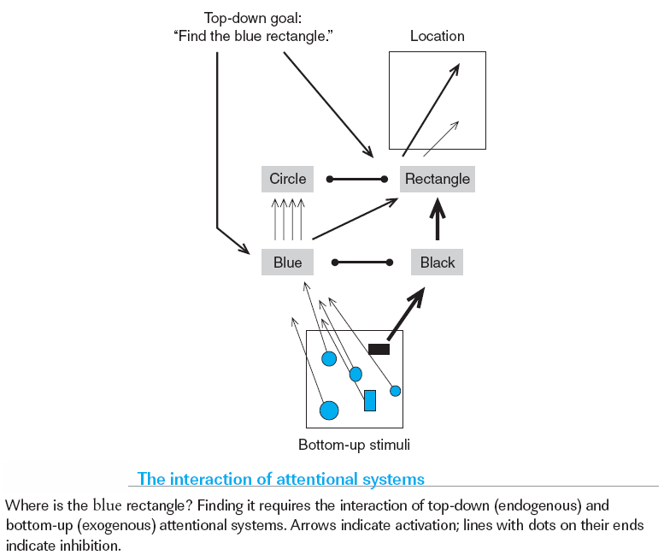
Functional Neuroimaging and Transcranial Magnetic Stimulation

Slide 10
Competition: A Single Explanatory Framework for Attention?
Conceptualizations of selective attention have undergone many transformations over the history of attention studies. Early theories drew analogies between attention and a filtering mechanism or bottleneck that operated in accordance with a set of early perceptual or later semantic criteria.
Later theories recast attention as the selective distribution of a limited amount of cognitive resources.
Now attention was seen not as a discrete gateway or bottleneck but as a modulatory influence that could increase or decrease the efficiency with which demanding processing is performed.
Click here for A CLOSER LOOK

Slide 11
Brains
Executive Control – the direction of central attention
Prefrontal Cortex

Slide 12
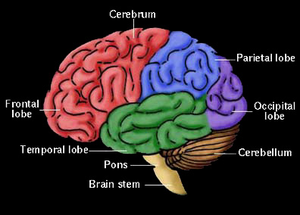
Networks
Posterior
Attention
Network
Anterior Attention Network

Slide 13
Posterior Network
Near parietal and occipital lobes
Involved in visual search
Posterior
Attention
Network
Anterior Attention Network

Slide 14
Anterior Network
Frontal and Temporal lobes
When focus is on one stimuli over another.
Involves inhibition of response.
Posterior
Attention
Network
Anterior Attention Network

